Slide 1
Serverless Basics
Frank Siler me@franksiler.com
2021-09-16

Slide 2
#include <disclaimer.h>
Notes:
Everything here is my own opinion and not coming from my employer or anyone else. Nothing I say should be construed as an endorsement of any particular product or methodology.

Slide 3
So what is this “Serverless” thing, anyway?
My definition: Serverless is a set of principles and technologies to allow the construction of software which is
highly scalable
highly available
cost-manageable
decomposable
geographically distributed
capable of being monitored

Slide 4
How do you go about that?
Thoughtworks laid out these ideas. Some of the important characteristics of serverless systems are:
Low barrier to entry
Hostless
Stateless
Elastic
Distributed
Event-Driven
https://www.thoughtworks.com/en-us/insights/blog/traits-serverless-architecture

Slide 5
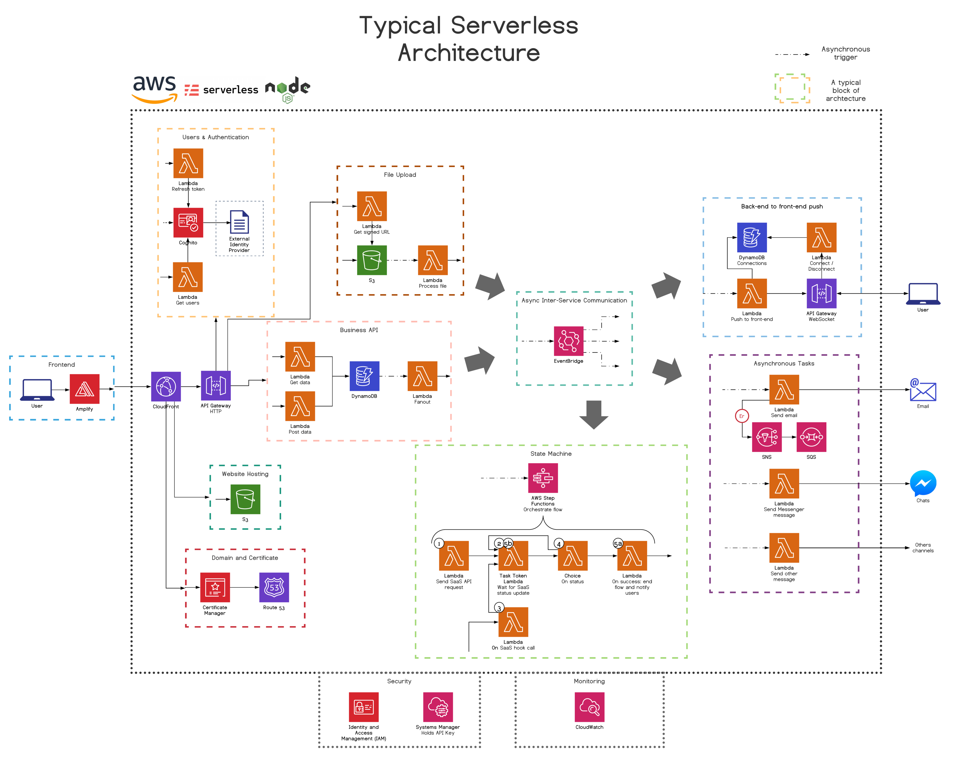
It doesn’t have to be complicated…..
https://medium.com/serverless-transformation/what-a-typical-100-serverless-architecture-looks-like-in-aws-40f252cd0ecb

Slide 6
How would you do it in the old days?
A simple static website:
DNS
Web Server
index.html
Probably from your DNS registrar or maybe your webhost
nginx, Apache, IIS
File on disk
Your host computer

Slide 7
The Serverless Version
Cloud DNS provider, eg Route 53
Cloud Storage Provider eg S3, GCS, Azure Storage

Slide 8
So what’s the big deal?
You didn’t change much!
Exactly. Except that instead of running on one computer, we are now running on a vast distributed network.
For many applications, this will cost you less and have higher uptime than the old model. BUT…
An aside. Cloud is not ideal for everything. It has significant advantages for workloads that are:
Bursty or unpredictable
Experimental
Geographically distributed
You must do your own math and understand your own application to make an intelligent decision. Don’t be breathless about any given technology.

Slide 9
Quick Commentary on the Big Three
GCP: most developer friendly
Upside: Super cool databases: BQ, Spanner, BigTable
Downside: losing money, not platform company / deprecation policy
Azure: obvious choice if you’re a Microsoft shop, particularly for MSSQL
Upside: great integration for Windows stuff but also OSS friendly, privacy
Downside: cost
AWS: suggest choosing only if they have a specialty service you need
Upside: lots of specialty services (eg, Satellite Downlink)
Downside: janky. Poor documentation. A friend of a friend was the sole responsible person for EC2 for 12 hours a day.

Slide 10
So what technologies do we use?
Technologies to connect
Technologies to remember
Technologies to process and understand
Technologies to diagnose and manage

Slide 11
Technologies to connect
HTTP gateway
CDN
Subnet
VPN
Firewall
Site-to-site connection
Message queues
Notification system

Slide 12
Technologies to remember
Object storage / artifact repository
Caching databases: memcache, redis
Distributed databases: MongoDB, Cassandra, CouchDB
Then the big boys- proprietary, globally distributed:
AWS: DynamoDB, RedShift
GCP: Firestore, BigTable, Cloud Spanner, BigQuery
Azure: CosmosDB
And then possibly the most interesting: modern serverless databases with old-school APIs:
AWS: Aurora (MySQL and PostgreSQL), DocumentDB (MongoDB)
GCP: Atlas (MongoDB)
Azure: Azure SQL Database (MSSQL), Azure DB for PostgreSQL

Slide 13
Technologies to process and understand
Functions and general compute
Machine Learning
Sentiment analysis
Text and document processing
Image and video processing
Speech processing
Agents
Translation
Search

Slide 14
Technologies to diagnose and manage
Logging
Tracing
Monitoring
Profiling
User management
Source control
Deployment tools
Cost management

Slide 15
Third Party products
Auth0 – login
Twilio – telephony

Slide 16
Limitations of serverless
Your whole world generally belongs to someone else
Vendor lock-in
Latency, costs, tech support
The world can shift underneath you
Can be annoying to debug
Cold Starts
Limited runtime support
Per-unit costs (OpEx) tend to be higher
Local dev can be more complex than more traditional setups
Fewer tools set up for it
https://www.oreilly.com/library/view/what-is-serverless/9781491984178/ch04.html

Slide 17
Some example applications

Slide 18
Example: S3 archiver
So here’s the thing: by default, you upload to the “Standard” storage class, which is $0.023/GB in us-east1. By contrast, “Deep Glacier” storage is nearly 25x cheaper
But here’s the thing: you pay for “operations”, which include the copy that you need to change storage classes, and you also pay for 8KB of Standard storage and 32KB of Glacier for every object in Glacier.
Therefore, it never makes sense to archive objects 8KB or smaller

Slide 19
Example: auto transcode on video upload
Didn’t have a chance to get this up and running, but it’s the same kind of idea, except that we’re kicking off an outside task
https://motorscript.com/automate-aws-elastic-transcoder-s3-files-using-lambda-functions/

Slide 20
Example web app: FatPitch

Slide 21
Questions?

Slide 22
Resources
Possibly my favorite introductory talk: Sam from ACloudGuru https://youtu.be/Cd0qLRkTubk
For the old-fashioned (but still valid) way:
Hosting deals aggregator: lowendbox.com
Hosting: ssdnodes.com
https://martinfowler.com/articles/serverless.html
https://www.oreilly.com/library/view/what-is-serverless/9781491984178/
Interesting blogs
http://rachelbythebay.com/w/
https://boyter.org/posts/abusing-aws-to-make-a-search-engine/

